Slide 1

After successfully completing this session you will able to understand below topics:
Packet switching and circuit switching
Headers (IP and Ethernet)and packet flow with practical explanation.
Types of Data flow
Broadcast domain and collision domain
Physical layer devices (HUB, Repeater, Bridge, DWDM)
What is IP address and Ranges IP addresses.

Slide 2
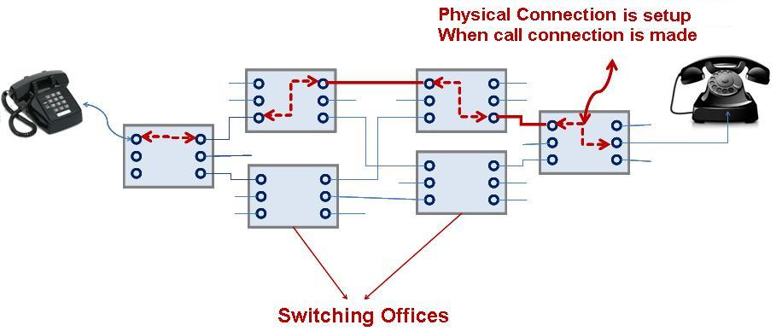
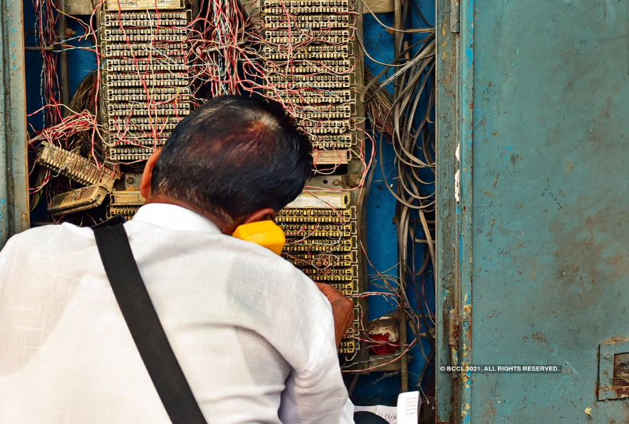
Circuit switching
a circuit switch created a temporary and dedicated link of fixed bandwidth between communicating end nodes. This link only lasted until the call was complete. If there weren’t enough network resources available, the call wouldn’t be established or “completed as dialed.”

Slide 3
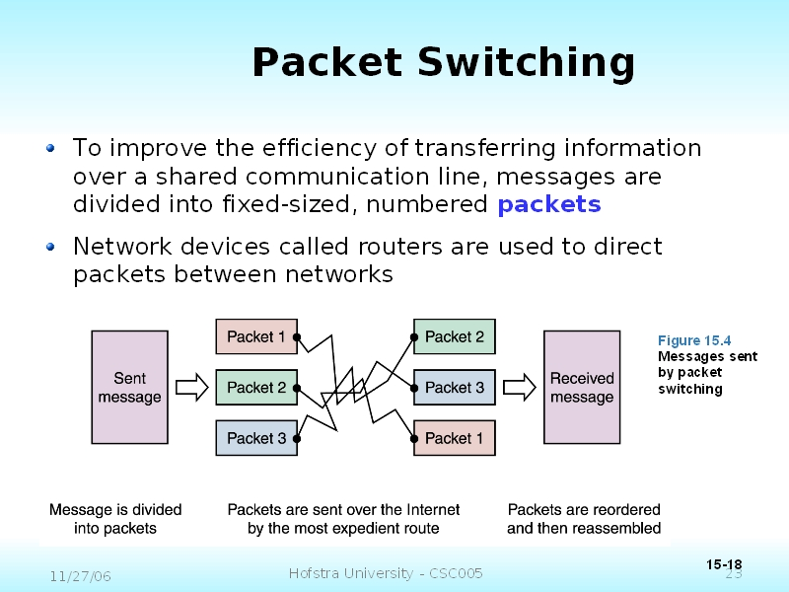
Packet switching
Packet Switching transmits data across digital networks by breaking it down into blocks or packets for more efficient transfer using various network devices.

Slide 4
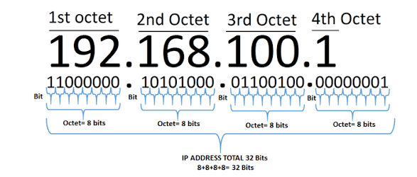
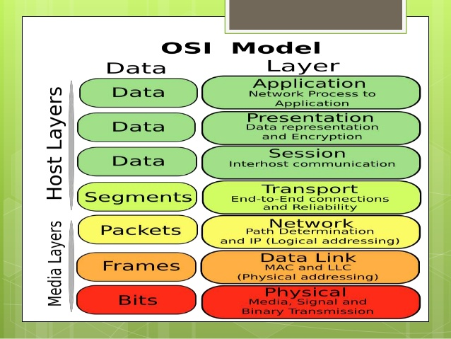
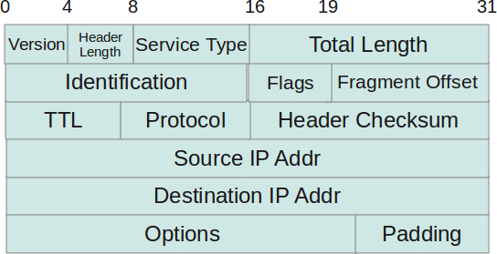
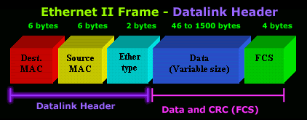
Ethernet header and IP Header

Slide 5
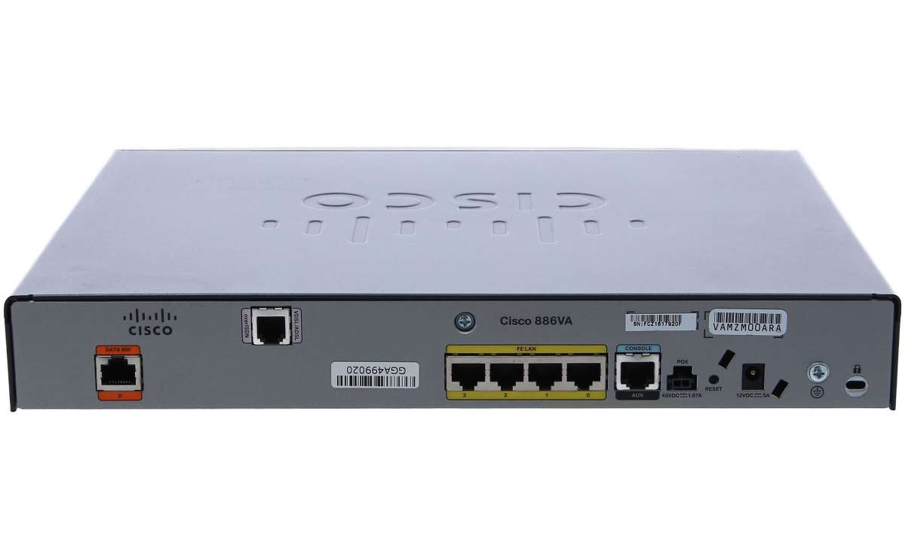

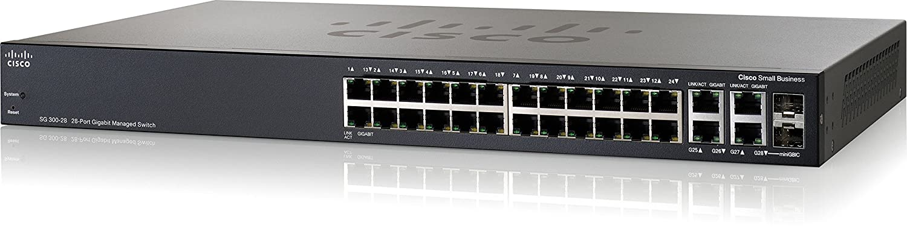
Data flow
Routing Table
192.168.2.2 exit 1/1
Router –Network Layer
Router each port 1BD, 1CD
Switch is having all ports 1 BD each port 1CD
Switch- Data link layer
PC-B
Switch Maintains the mac-address Table
Ping 192.168.1.2
Port MAC address
1/1
AA
BB
1/3
RR
192.168.1.2
PC-A
192.168.1.1
Soucre MAC AA
Destination MAC FF: FF:FF
Source 192.168.1.1/24
Destination 192.168.2.2

Slide 6
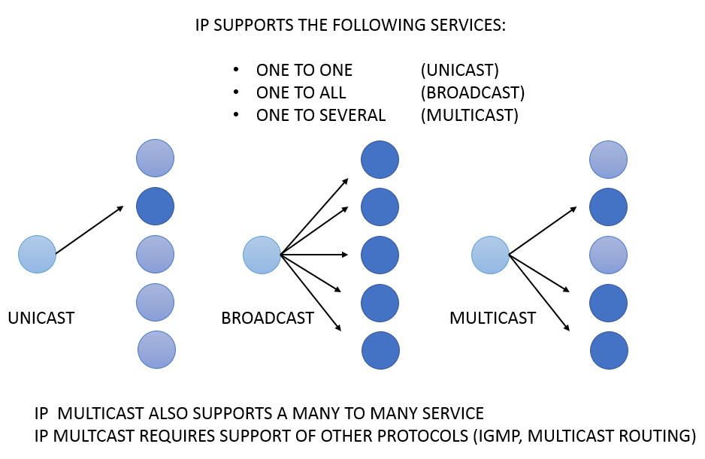
Traffic flows
Whereas an unicast message is only sent to one station on the network.
Broadcast messages are sent to all stations in the network.
Multicast messages are sent to a group of stations, for example video cameras type. Using multicast allows the building of distribution networks, which are suitable for Video monitoring or television transmissions over the Internet, i.e. information with one sender and many receivers.
IPv4 addresses as 255.255.255.255 or 192.168.0.255 are BROADCAST IP addresses.
IPv4 addresses from 224.0.0.0 to 239.255.255.255 are MULTICAST IP addresses.
Broad cast MAC FF:FF:FF:FF:FF

Slide 7
Broadcast domain and collision domain
Collision Domain – A Collision Domain is a scenario in which when a device sends out a message to the network, all other devices which are included in its collision domain have to pay attention to it, no matter if it was destined for them or not. This causes a problem because, in a situation where two devices send out their messages simultaneously, a collision will occur leading them to wait and re-transmit their respective messages, one at a time. Remember, it happens only in case of a half-duplex mode.
Broadcast Domain – A Broadcast Domain is a scenario in which when a device sends out a broadcast message, all the devices present in its broadcast domain have to pay attention to it. This creates a lot of congestion in the network, commonly called LAN congestion, which affects the bandwidth of the users present in that network. From this, we can realize that more the number of collision domains and more the number of broadcast domains, the more efficient is the network providing better bandwidth to all its users.

Slide 8
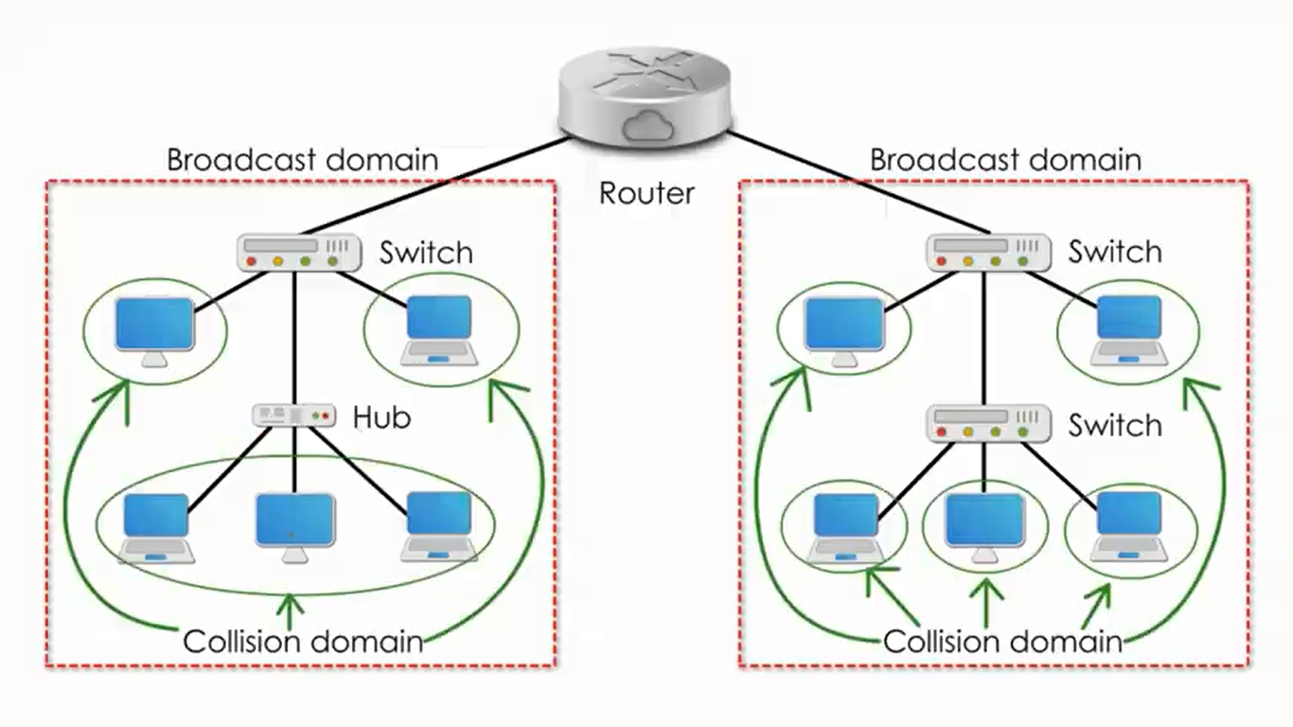

Slide 9
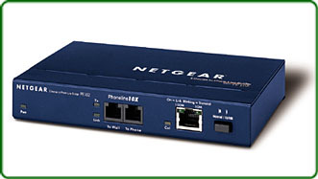
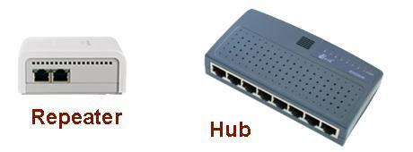

Repeater, HUB and Bridge:
Repeater – A repeater operates at the physical layer. Its job is to regenerate the signal over the same network before the signal becomes too weak or corrupted so as to extend the length to which the signal can be transmitted over the same network. An important point to be noted about repeaters is that they do not amplify the signal. When the signal becomes weak, they copy the signal bit by bit and regenerate it at the original strength. It is a 2 port device.
Hub – A hub is basically a multiport repeater. A hub connects multiple wires coming from different branches, for example, the connector in star topology which connects different stations. Hubs cannot filter data, so data packets are sent to all connected devices. In other words, collision domain of all hosts connected through Hub remains one. Also, they do not have the intelligence to find out best path for data packets which leads to inefficiencies and wastage.
Bridge – A bridge operates at data link layer. A bridge is a repeater, with add on the functionality of filtering content by reading the MAC addresses of source and destination. It is also used for interconnecting two LANs working on the same protocol. It has a single input and single output port, thus making it a 2 port device.

Slide 10
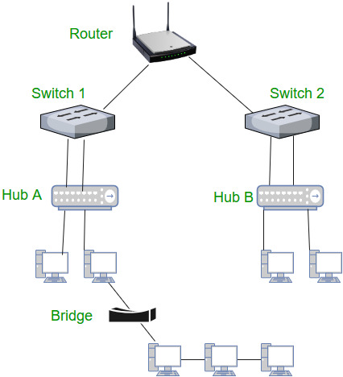
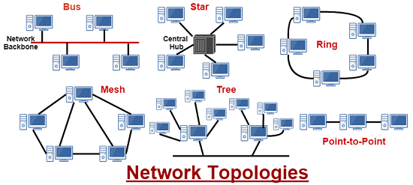

Slide 11

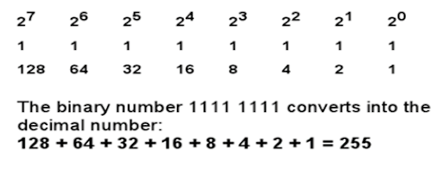
IP Address
Each IPv4 address is 32 bit and represented in decimal format in 4 octets. Each octet has 8 bits.
0000 0001
10100011
128+32+2+1=163

Slide 12
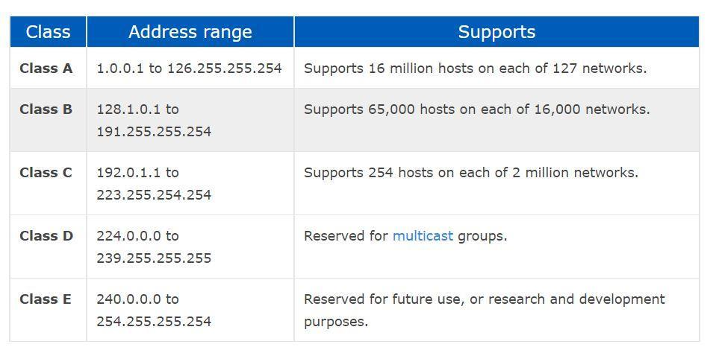
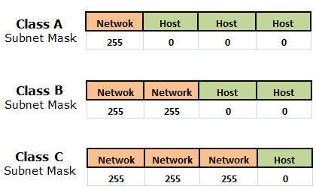
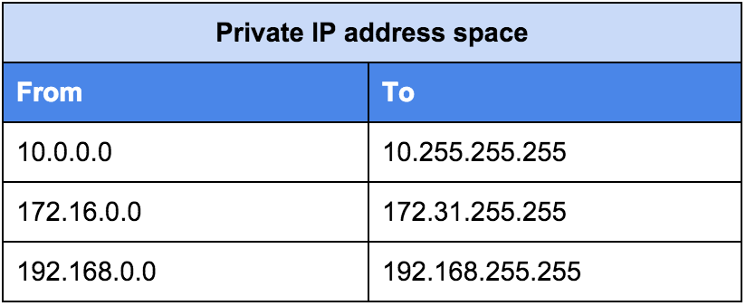
8

